Slide 1

DS-670(CAPSTONE:BIG DATA AND BUSINESS ANALYTICS)
JYOTHSNA

Slide 2

Problem statement:
Our goal is to predict crimes especially during the evening time in Boston
For this we got the data from boston.gov which is a latest dataset comprises of 2015 to 2020 crimes happened in Boston along with geographic information
Our predictions include type of crime during evenings, group of crimes according to the time, year , area, day, month and geographic coordinates
We also did some spatial analysis to identify the most common crime areas

Slide 3
Application of our project
Boston government can use our model in predicting the most common type of crime occurring in the Boston city
It can be helpful in controlling the crime rate by increasing the security in those areas
Our main target is to create awareness amongst Boston people about the type of crimes happening especially during the nighttime
Safety measures to be taken before we step out of the house during nighttime.
Our models can be helpful to most of the real estate companies in selling their properties based on the crime location
cont.….

Slide 4

Cont.…
It is also helpful for businesses to identify less crime places and plan their business accordingly
Our models can be deployed in house rental application to view the geographical crime spots in and around the houses which customers are planning to move.

Slide 5
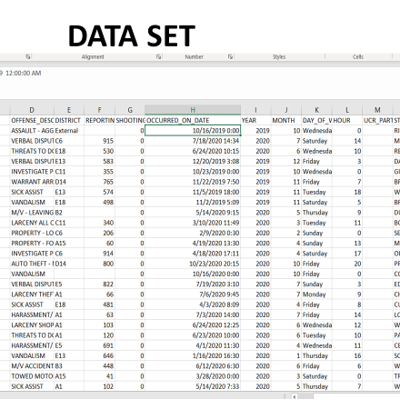
A short snap of our dataset and its features
INCIDENT_NUMBER’, 'OFFENSE_CODE', 'OFFENSE_CODE_GROUP', 'OFFENSE_DESCRIPTION', 'DISTRICT', 'REPORTING_AREA', 'SHOOTING', 'OCCURRED_ON_DATE', 'YEAR', 'MONTH', 'DAY_OF_WEEK', 'HOUR', 'UCR_PART', 'STREET', ‘LAT', ‘LONG', ‘LOCATION'

Slide 6
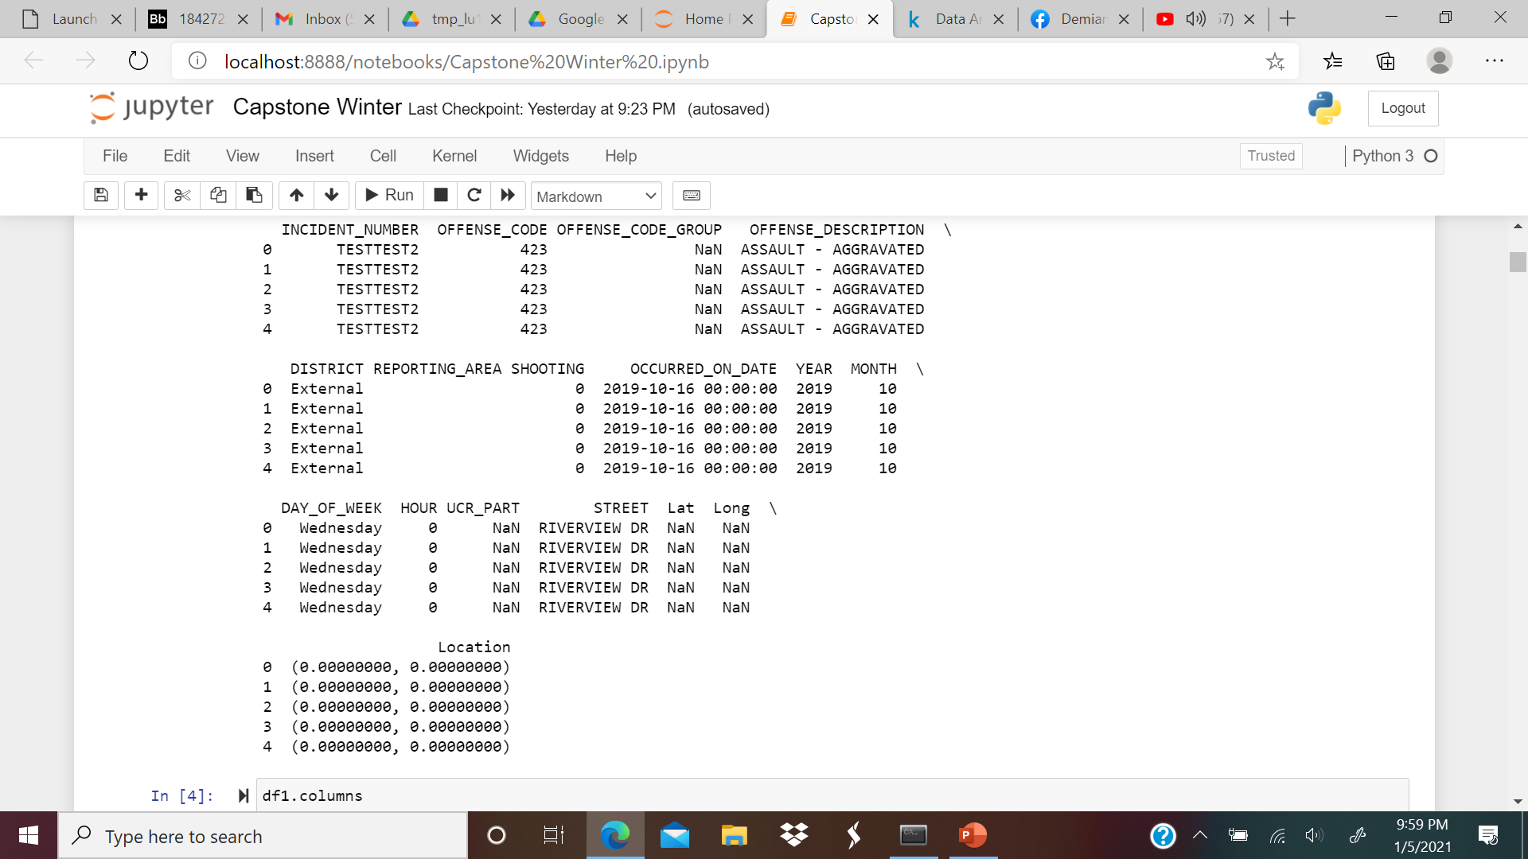
About the Dataset
There are 2,009,520 rows and 17 columns in the dataset.

Slide 7
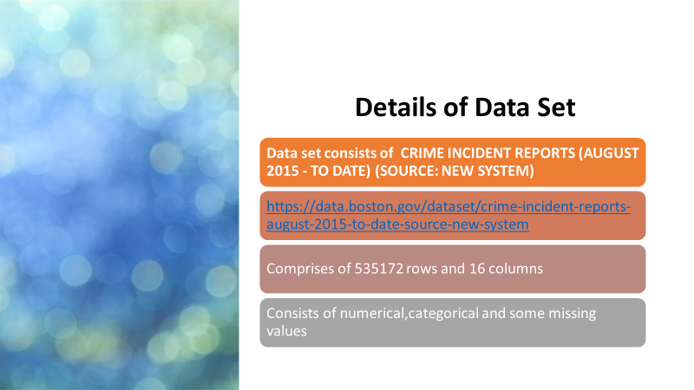

Slide 8
Tools used for analysis
Excel
Jupyter notebook
Tableau

Slide 9
Libraries used for Research
NumPy
Pandas
Matplotlib
Scikit
Geopandas
GDAL/OGR
RSGISLib
PyProj
Pywedge
Re (regular expressions)
ReportLab
Pysal
GDAL
Rasterio
Folium
Scikit image
Descartes
Xarray
Seaborn

Slide 10
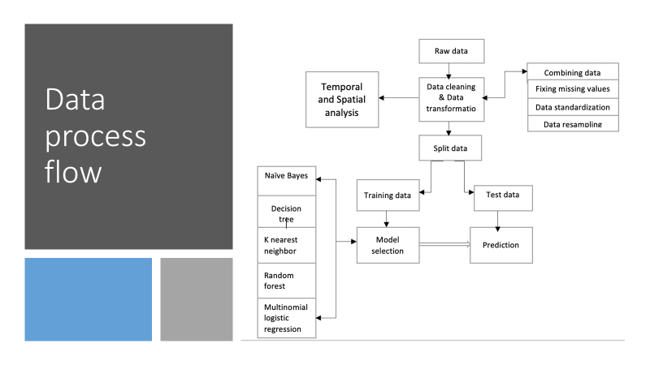

Slide 11


Slide 12
Introduction
This EDA looks at crime incident reports in the city of Boston provided by Boston Police Department(BPD)from June 2015 to till date to document the initial details surrounding an incident to which BDP officers respond.
This is a dataset containing records from the new crime incident report system, which includes a reduced set of fields focused on capturing the type of incident as well as when and where it occurred.
The data is originally provided by Boston's Gov Website. Records in the new system begin in June 2015

Slide 13
Literature Analysis
We started analysing this project in view of how safe Boston is when compared to other cities around in the united states. According to recent studies published as of today Boston seems to get better year after year.
Vision Zero Boston is Cities commitment to focus the City’s resources on proven strategies to eliminate fatal and serious traffic crashes in the City by 2030,
Beantown’s incidence of rape (39 per 100,000, putting it third on the list of cities in the survey) and assault (483 per 100,000, fifth on the list of cities in the survey) [external data Source] it might seem like a surprisingly dangerous big city.
The city also has the second-lowest incidence of vehicle theft at a rate of 258 per 100,000 and fares well on the other crimes rates.
Is it true to say that Boston was more violent than New York and Seattle, but less violent than Chicago and Las Vegas, according to numbers from the FBI, based on crimes committed back in 2015
After digging up and analysing the data what we found out that in recent numbers from the Boston Police Department, or BPD, show that violent crime, as well as property crime, has continued to drop, and has been steadily dropping for past years.
We have successfully done analysis which covers crime map based on Streets,Districts and robberies, as well as property crimes such as burglaries, auto thefts, larcenies for data of date and locations where medical assistance is needed between August 2015 till today.

Slide 14
Steps followed for Data Preprocessing
Data Preparation and Importing Datasets
Importing necessary Libraries
Statistical Analysis Exploration
Missing Data Analysis
Glimpses of Incidents Year/Month/Day wise
Plotting the Graphs

Slide 15
Python Libraries and Tools Used
Python Libraries
Numpy
Pandas
Sci-kit learn
Matplotlib
Seaborn
Geopandas
Folium
Tools :
Jupyter notebook

Slide 16
Data Cleaning Process
Drop Duplicate Values
1
Drop NA values
2
Order the weekdays
3
Drop the unnecessary columns
4

Slide 17
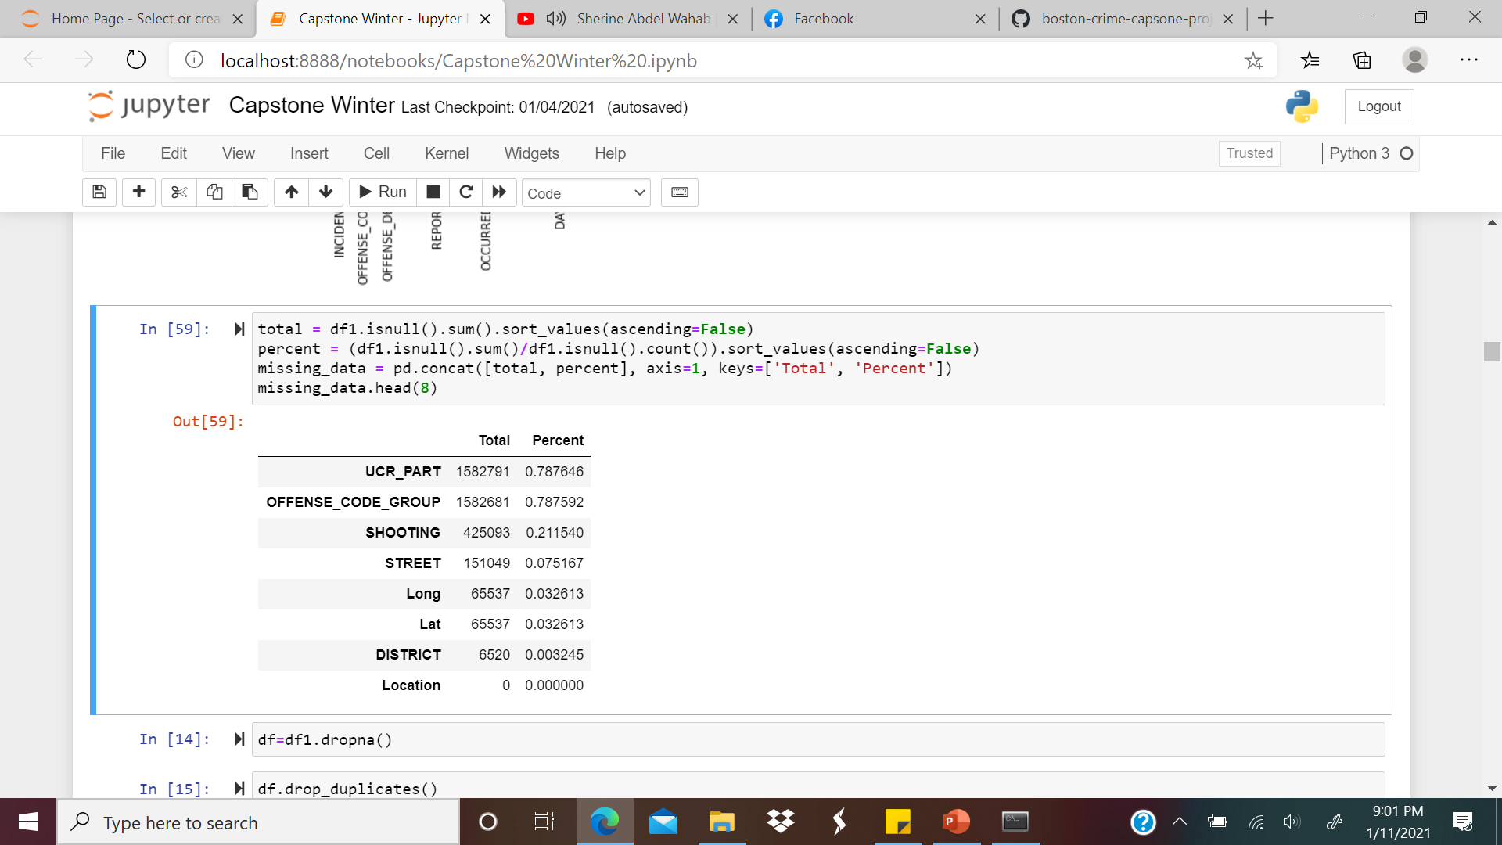
What is the percentage of Null values?
The percentage of null values for UCR_PART is %0.78
The percentage of null values for OFFENSE CODE GROUP is %0.78
The percentage of null values for SHOOTING is %0.21
The percentage of null values for STREET is %0.07
The percentage of null values for LONG is %0.03
The percentage of null values for Lat is %0
The percentage of null values for location is %0
Since there are less percentage of null values, we have dropped these values as this is not going to affect my analysis

Slide 18
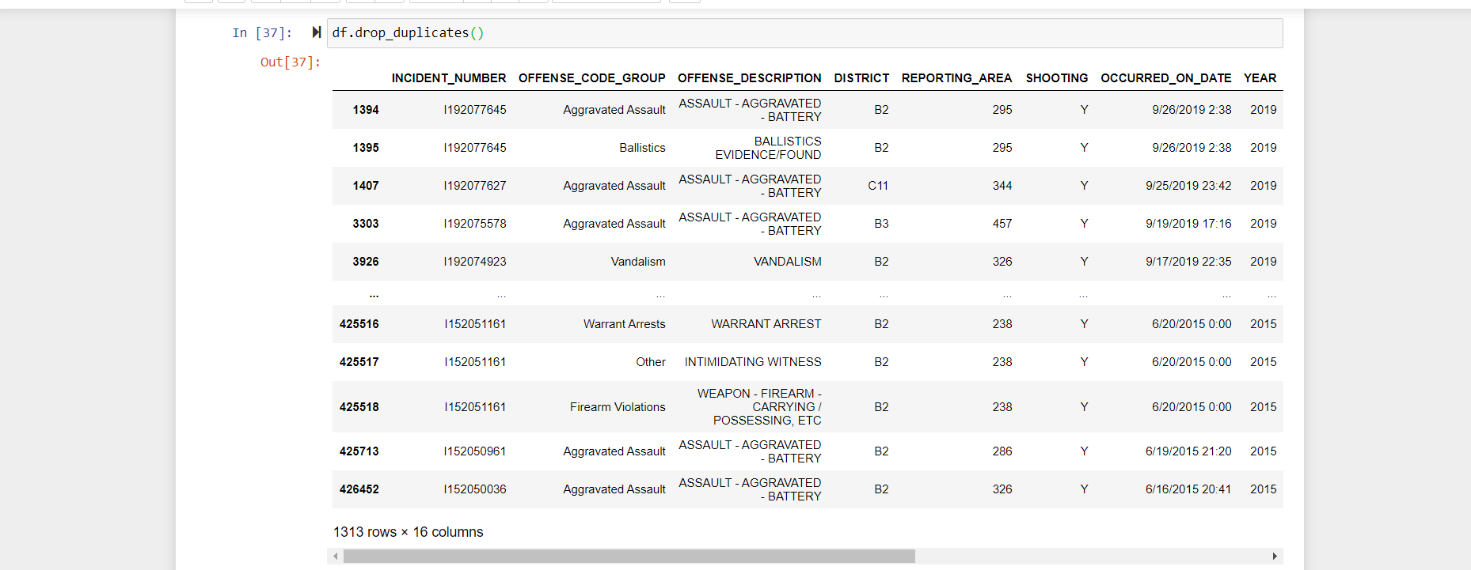
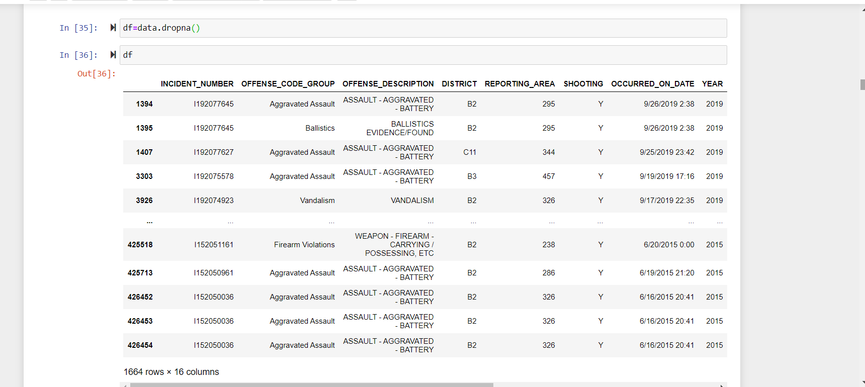
Dropping Duplicate and NA Values
DUPLICATE
NA VALUES

Slide 19
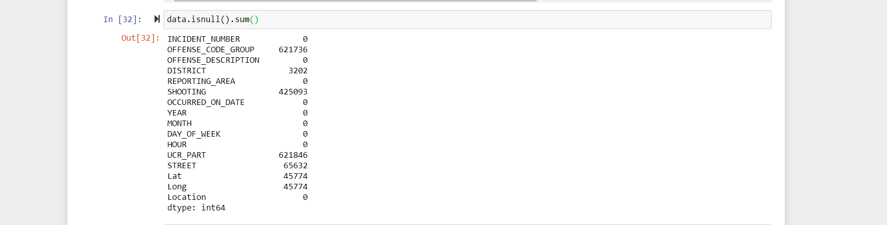
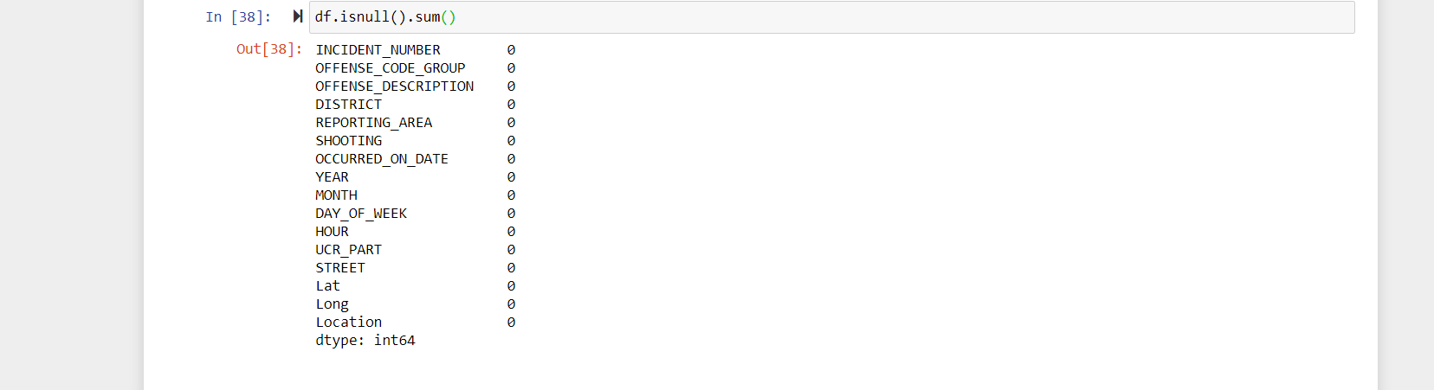
View of Dataset before and after cleaning

Slide 20
Exploratory Data Analysis

Slide 21

Reason for choosing Crime Data Set ?
Why we choose this dataset?
Performing an analysis of crime on the Boston dataset will help not only us but people living here to identify and analyze patterns in Boston’s crime incidents.
We believe that the results of this analysis can be useful to Police Department in how they use their resources, and to assist in identifying and recognizing suspects.
Never the less, it would help many foreign people living in Boston, to better understand the city of Boston and its surrounding area.

Slide 22
Analysis Goal and Objective
We found out the incidents backwards through time, for patterns by time and location and to visually represent these results.
These results are not only potentially beneficial to the Police Department, but they can also be beneficial for the People living in Boston to see and understand where and how often crime is happening in their neighborhood.
We hope that by understanding the frequency of incidents in a neighborhood, residents can be cautious about how they report incidents.

Slide 23
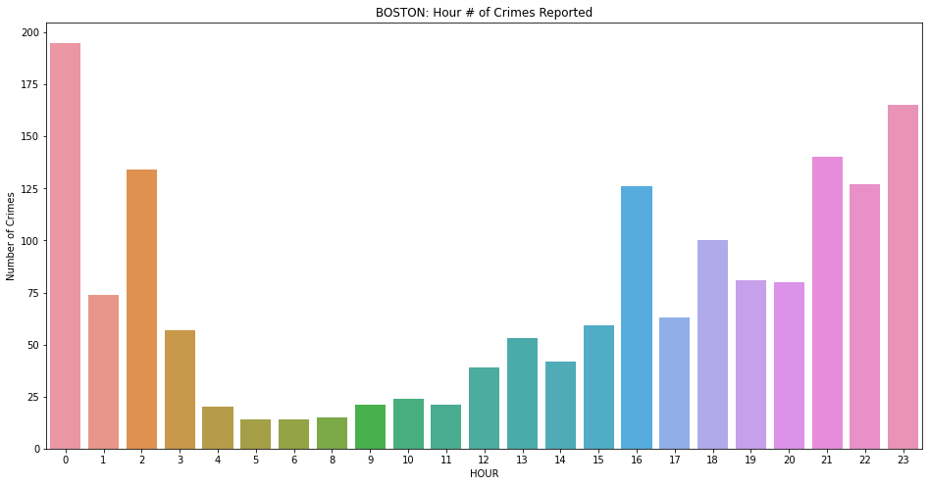
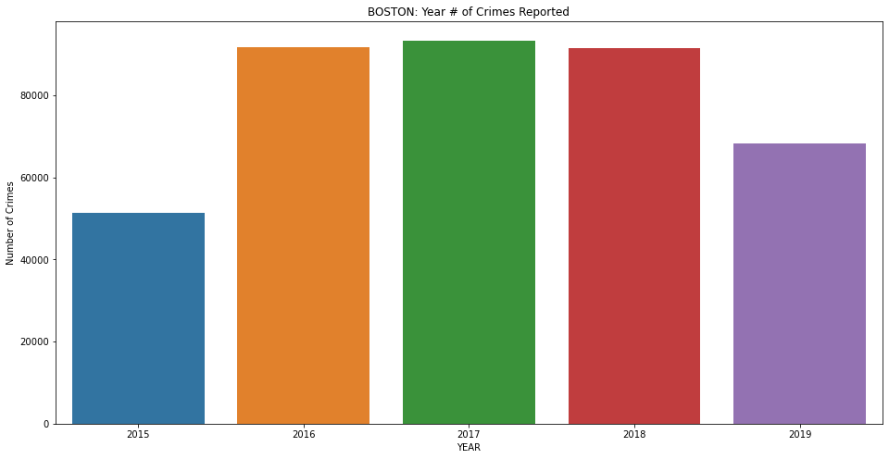
How many crimes happens per year?
In 2015, there were 51448 reported.
In 2016,there were 91728 reported.
In 2017, there were 93398 reported.
In 2018,there were 91521 reported.
In 2019,there were 68293 reported.
Most of the crimes happening in 21st,22nd and 23rd hrs. and crimes are less in 4th,5th,6th,7th,8th,8th,10th and 11th hrs..

Slide 24
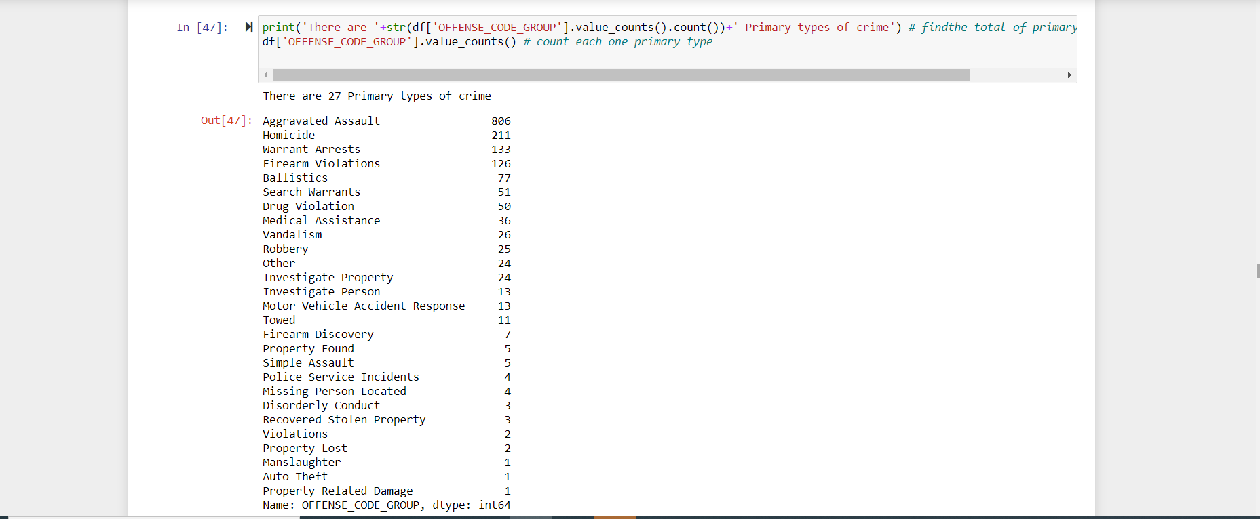
Primary types of Crimes

Slide 25
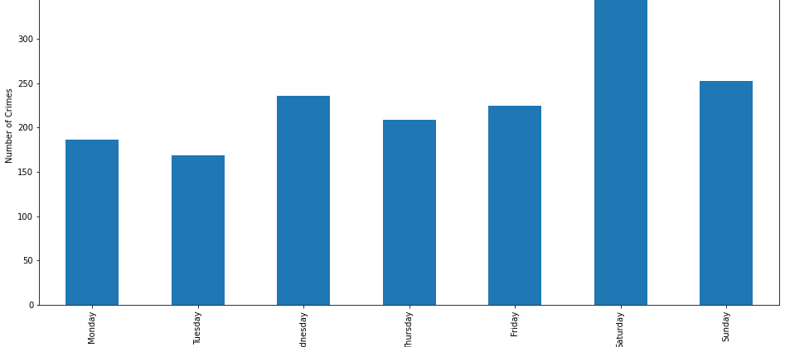
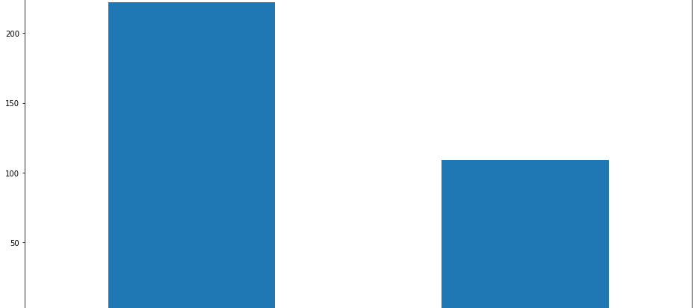
Day of week crime%
Most of the crimes happen on Saturday and Sunday (Percentage of crimes are more on weekends compared to weekday)
Day and night crimes were shown in a bar plot.

Slide 26
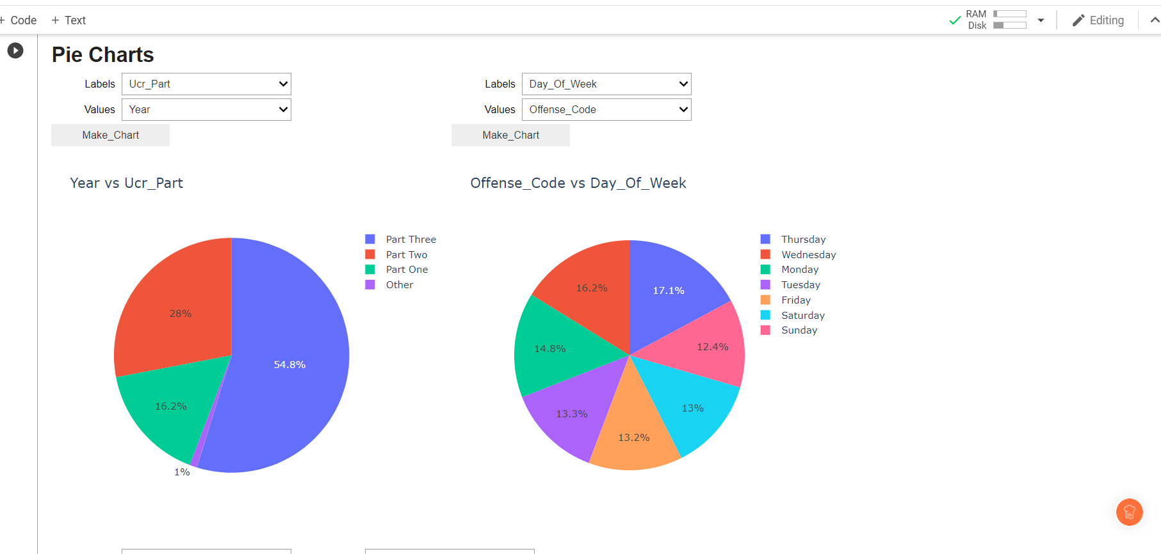
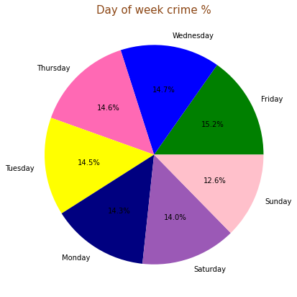
Pie Chart of Ucr_Part vs Year/Day_of_week vs Offense_Code/Day_of_week vs Percentage
1st Pie Chart :
In the Pie chart Ucr_Part 3 has highest percentage of crimes -54.8%
Ucr_Part 1 has lowest percentage of crimes -16.2%
Ucr_part other has 1% crimes
2nd Pie Chart :
Offense_Code are highest on Thursday and lowest on Sunday
3rd Pie Chart :
Friday had the highest percentage of crime reported (15.2%)
Sunday had the lowest percentage of crime reported (12.6% )

Slide 27
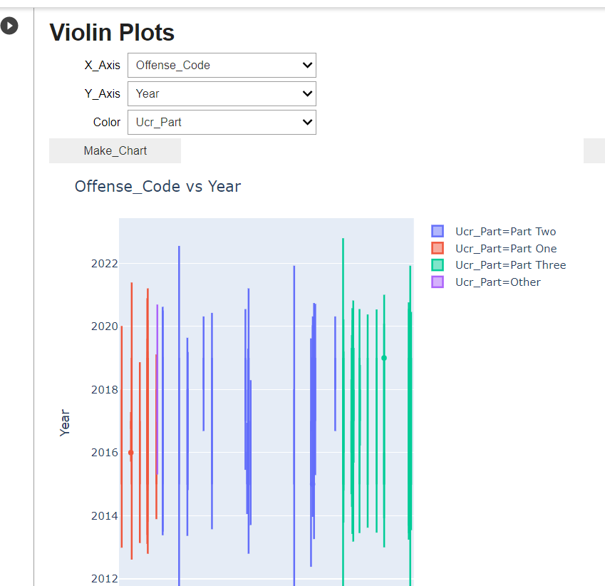
Violin Plot
Offense code were high in Ucr_Part 1 in the year – 2016
Offense code were high in Ucr_Part 3 in the year 2019

Slide 28
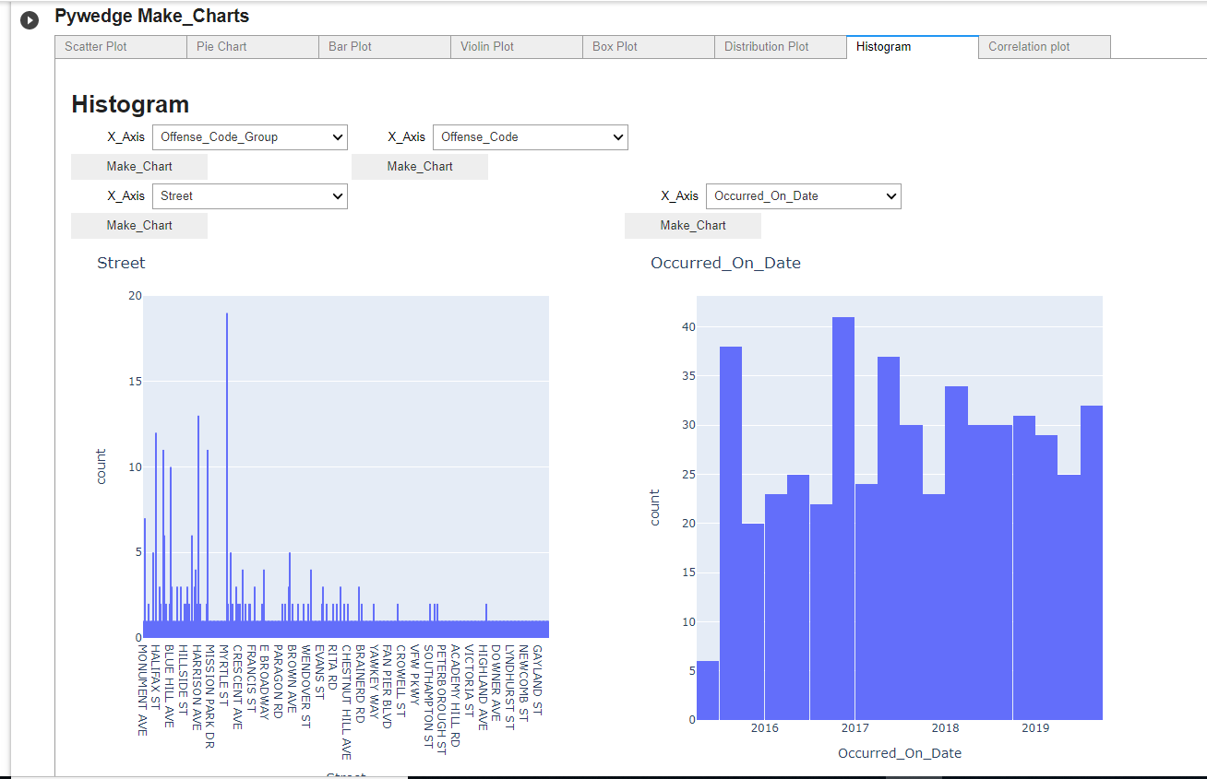
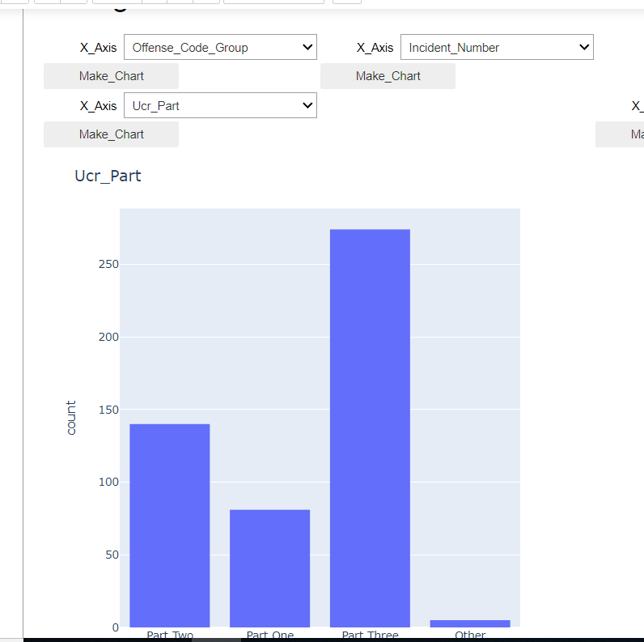
Histogram of offense_code_group vs street/offense_code vs occurred_on_Date/Offense_code_group vs Ucr_Part
Offense_code_group is high in Myrtyl street .
Offense code is high in year 2017 and low in year 2014
Offense_code_group is high in Ucr_Part 3 and low in Ucr_Part 1

Slide 29
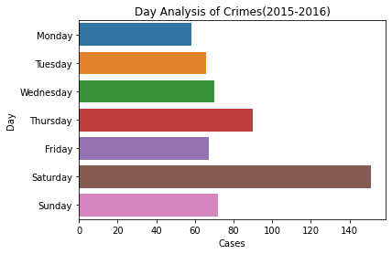
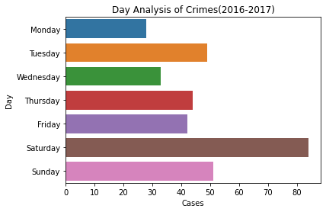
COMPARISION OF DAYANALYSIS CRIMES FROM (2015-2016 AND 2016-2017)
When we compare Day analysis crimes of 2015-2016 and 2016-2017 almost there is similarity major crimes happened in Saturday and in Tuesday the crime rate increased in 2016-2017 compared to 2015-2016

Slide 30
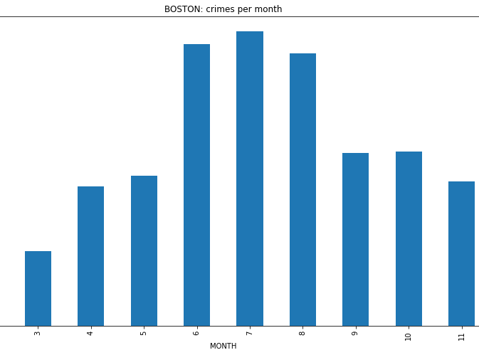
Crime rate of vs Month
July and August had the highest rate of crimes and March had the lowest rate of crime .

Slide 31
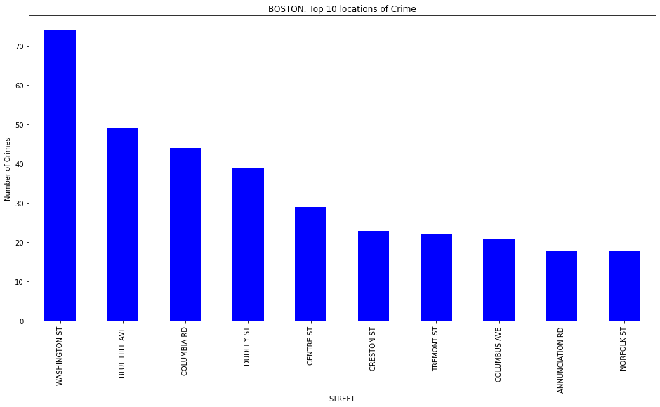
Crime rate vs top ten Streets in Boston
Washington ST was one of the top 10 locations of crimes and Norfolk St is the lowest crime reported street of top 10 ten streets.

Slide 32
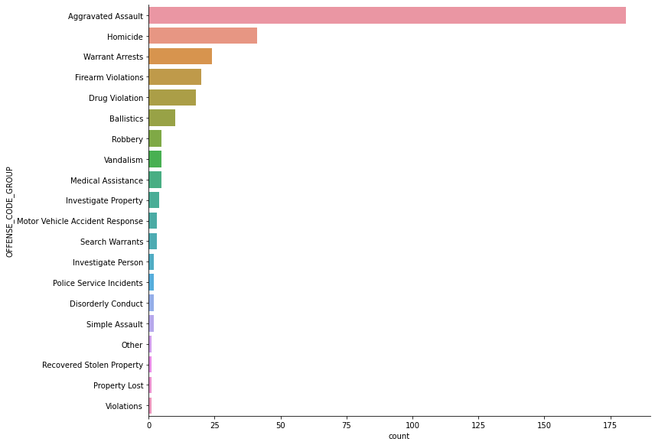
Types of Count of Offenses
Assault,Homicide,Warranty Arrests,Firearm violations and Drug Violations crimes are more in number

Slide 33
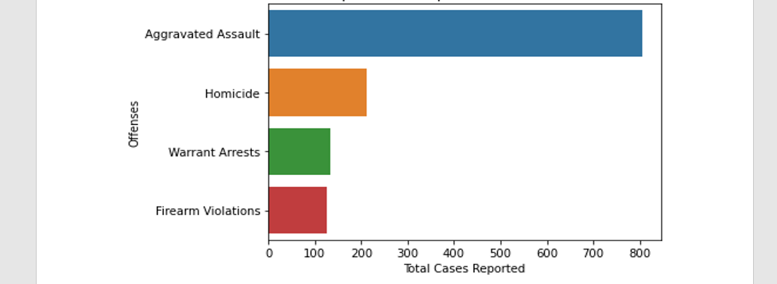
Top 4 Crimes from 2015-2019
Of the top 4 crimes reported Aggravated Assault is the highest, next is Homicide, third is warrant Arrests and least of top 4 is Firearm violations

Slide 34
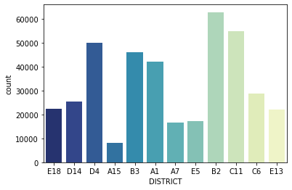
What are the districts with most crimes ?
District A15 has the lowest rate and B2 has the highest rate.C11 is the second highest in crime rate followed by D4,B3 and A1.

Slide 35
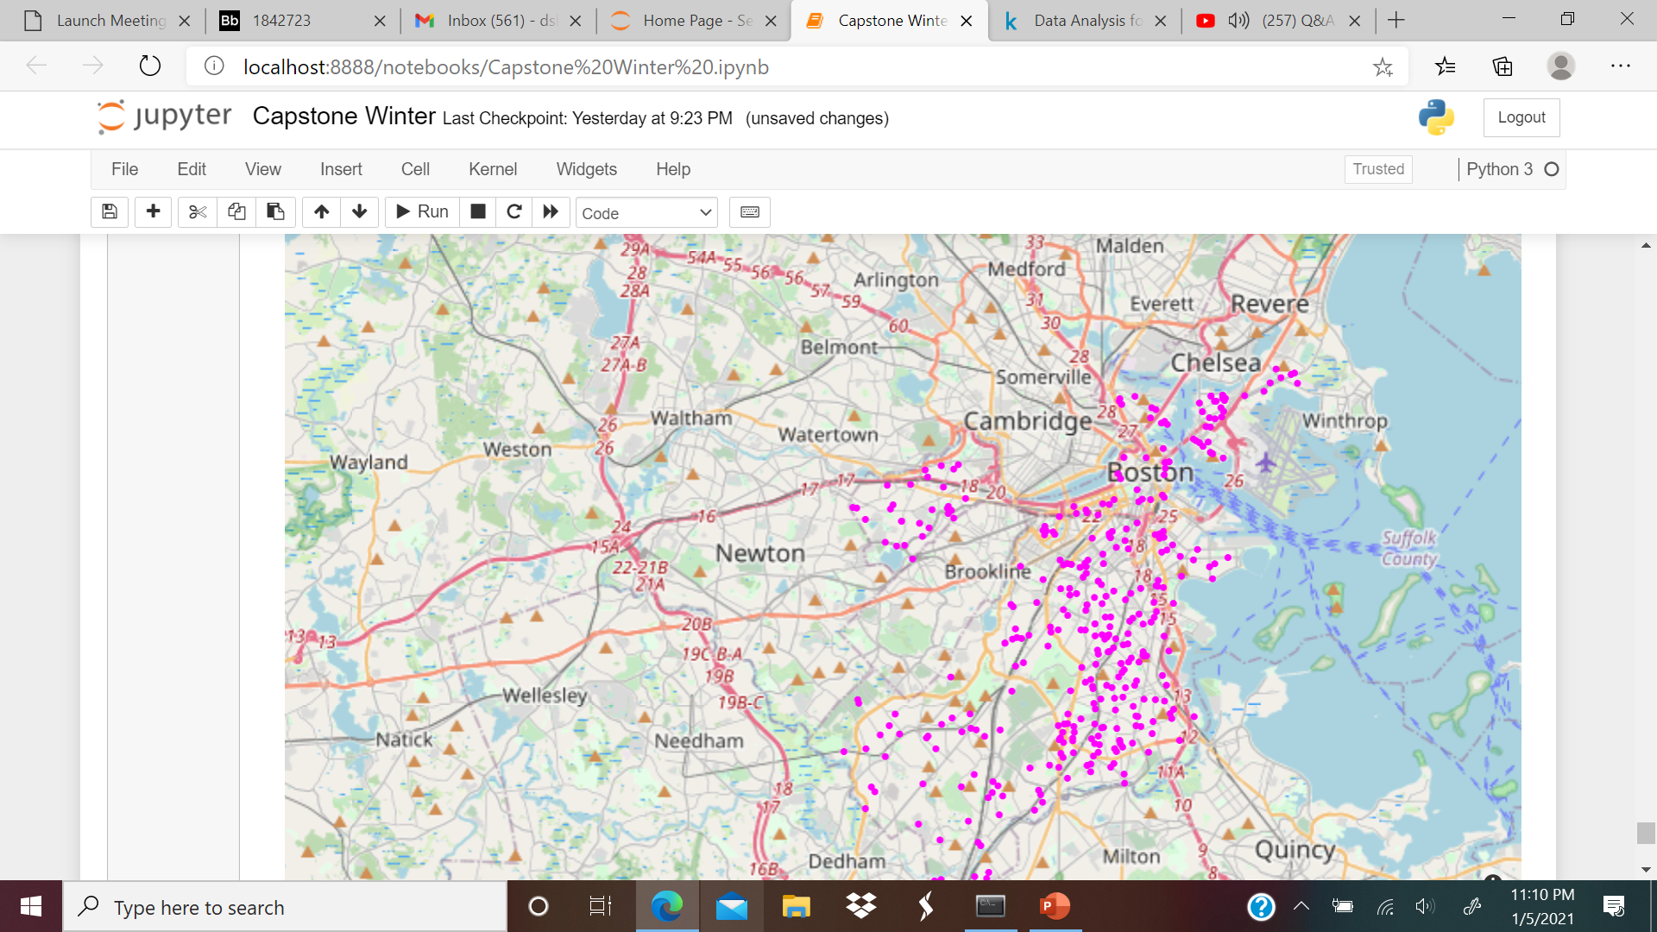
Crime Map
Most of the crimes happen in the heart of the city. When we see the pink hotspots most other crimes are happening in Bost City and surrounding areas.

Slide 36
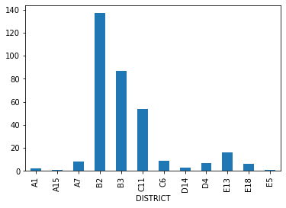
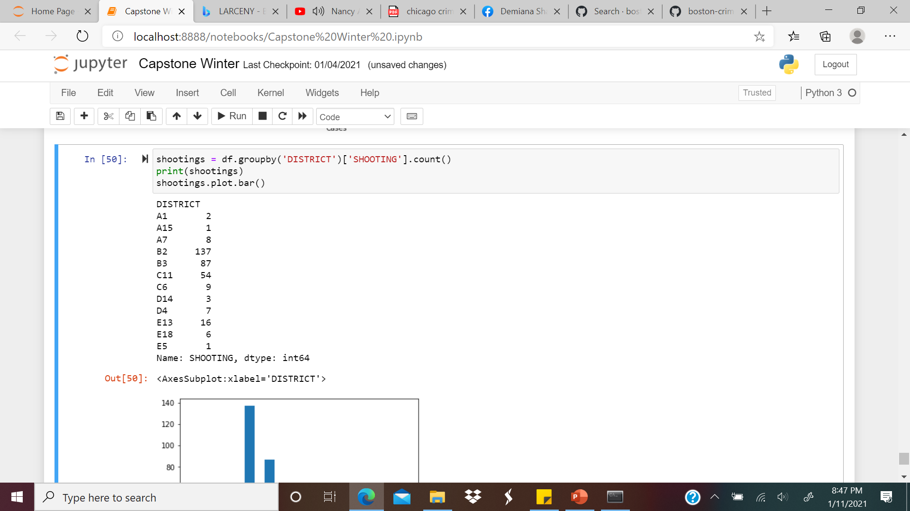
Shooting vs District
Highest number of shootings happened in B2 ,second highest is B3,third highest is C11 and very low shootings reported in District A1,A15,D14,E5,D4,E18,A7 and C6

Slide 37
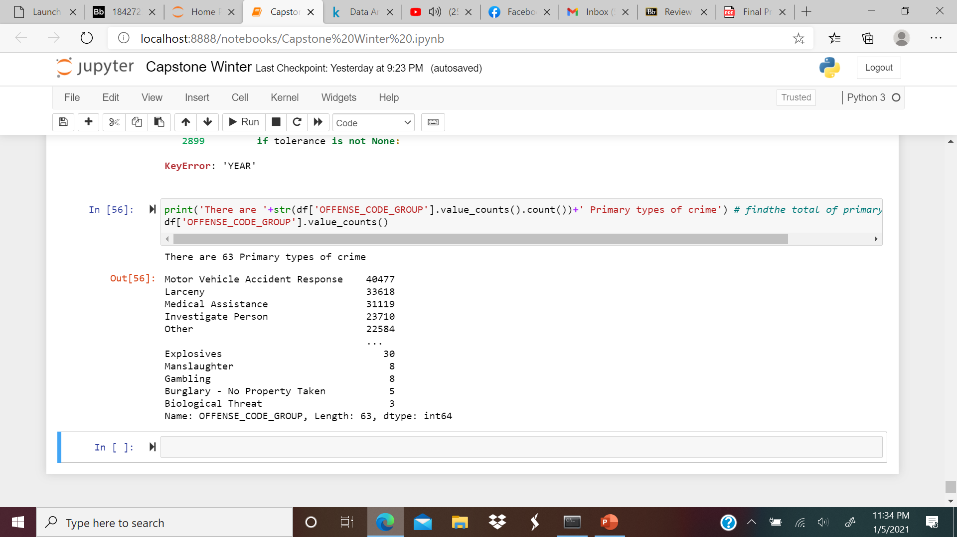
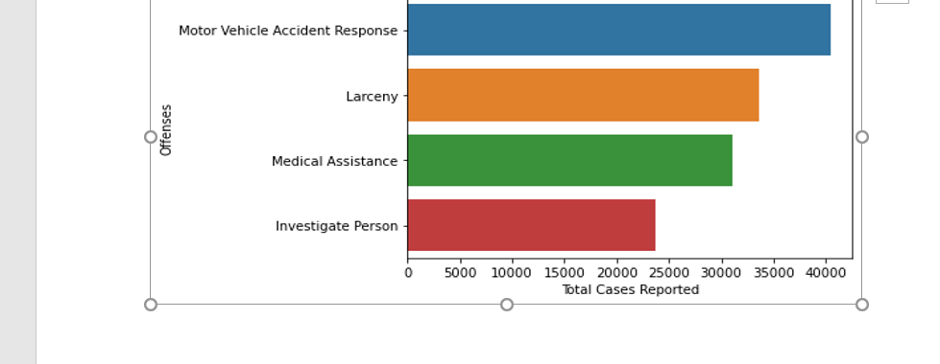
Major Crimes in Boston
There are 63 primary types of crimes (2015-2019):
Of 63 primary types top 4 crimes are :
There were 40477 motor vehicle accident response.
There were 33618 Larceny .
There were 31119 Medical Assistance .
There were 23710 Investigate Person .

Slide 38
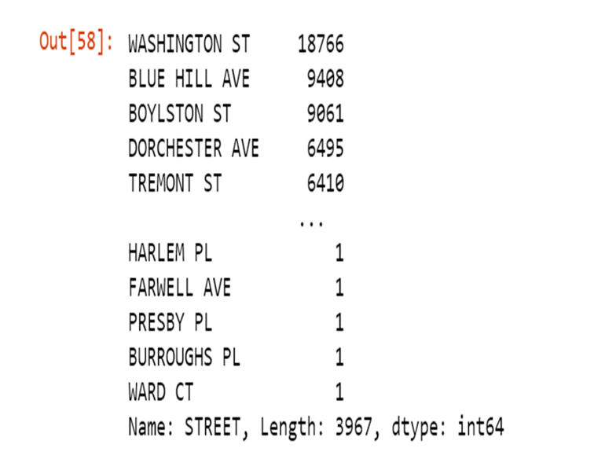
What are the least 5 locations of crime ?
Least 5 locations of crime are Harlem pl,Farewell Ave,Presby pl,Burroughs pl,ward CT

Slide 39
Further Analysis
This EDA just scratches the surface of the dataset.
Further analyses could explore how different types of crimes vary in time and space
Another interesting direction would be to combine this with other data about Boston, such as demography or even the weather to investigate what factors predict crime rates across time and space.

Slide 40
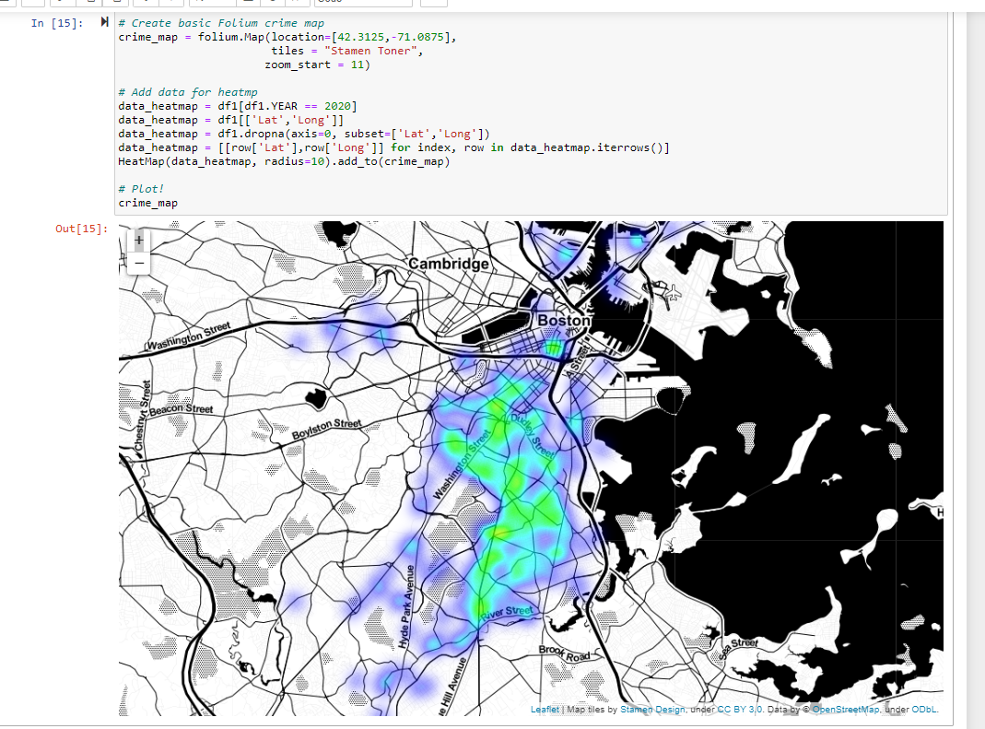
Spatial analysis View Streets in Boston with highest crime rate -2020
Streets with highest crime Rate
Washington Street
River Street
Dubley Street
Others Streets with Crime
Columbia Road
Seaver Street
Hills Avenue
Norfolk Street
Geneva Avenue
Quincey Street
Bowdon Street

Slide 41
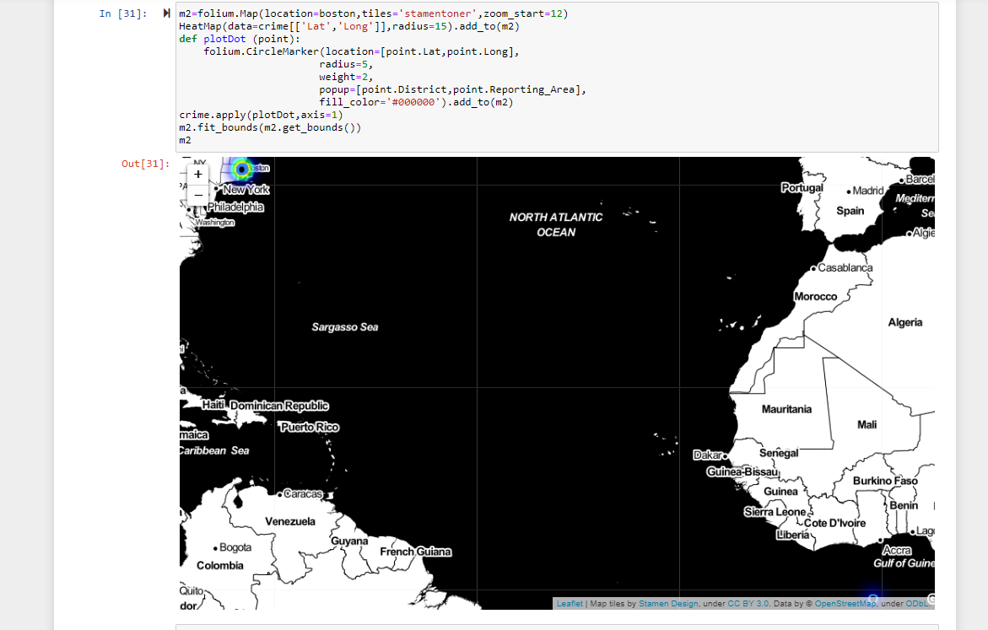
View Districts with highest crime rate
District 11- highest crime rate -939 crimes
District 8-lowest crimes recorded -26
District 0-566
District 1 -392
District 2 -453
District 3 -560
District 4 -912
District 5 – 542
District 6 – 273
District 9 – 125
District 10 -900
District 7 - 60

Slide 42
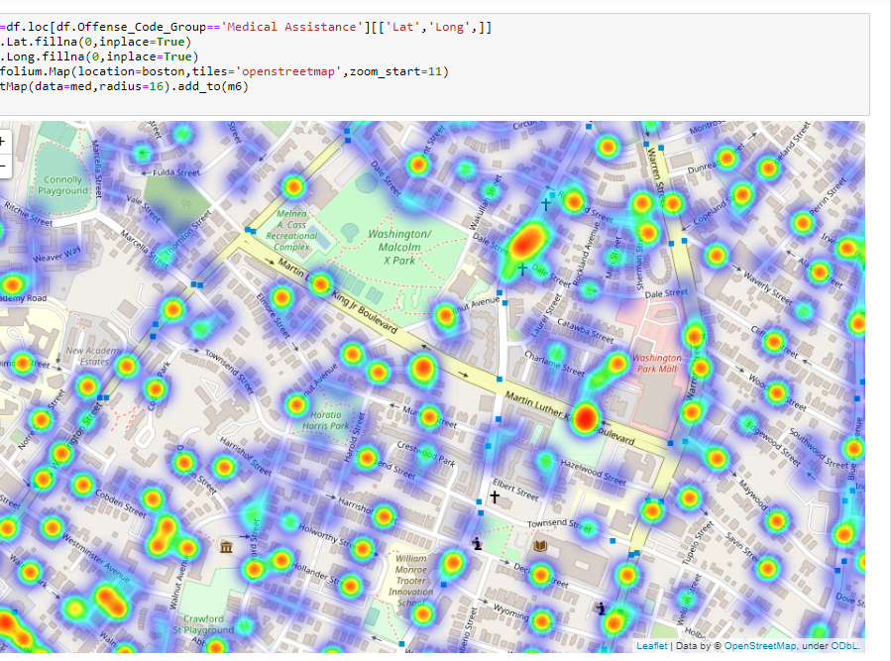
Locations where medical Assistance is needed
Crimes mostly happening near Parks,Malls,Recreational Complexes, Streets and near Playgrounds where Medical Assistance is required
Some of the hotspots are :
Harshishef street
Holworthy street
Waverly Street
Fulda street
Dale street
Holland street
Cobden street
Savin street

Slide 43
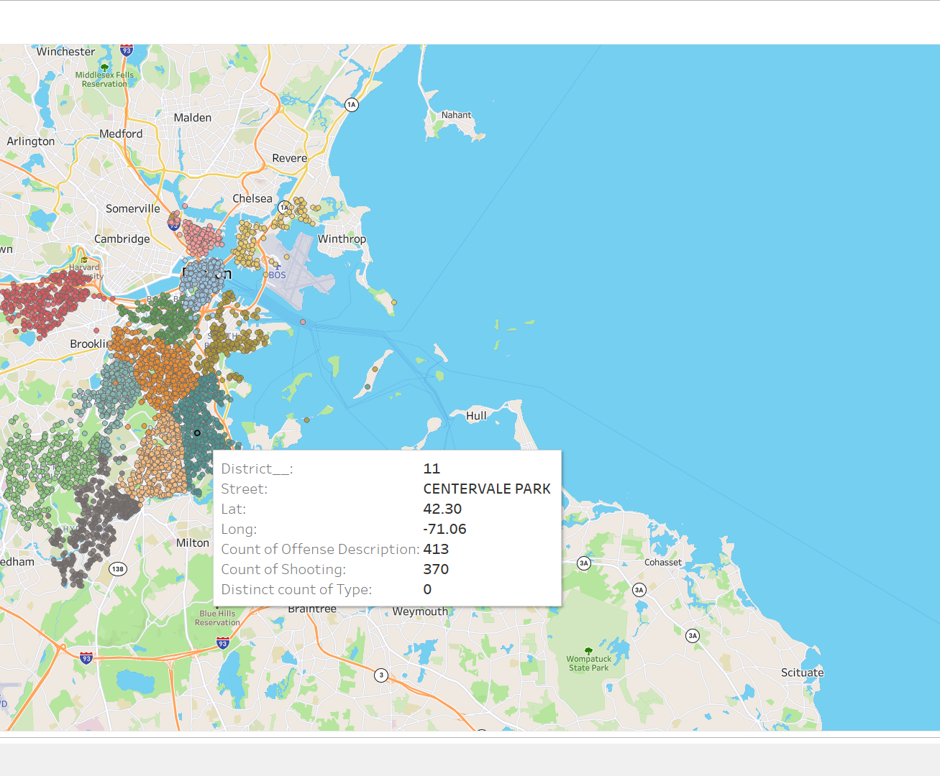
Geospatial Visualization for Offense crimes in Boston
Hotspots of offense
crimes are seen
Harvard City
Brooklyn
Dedham
Chelsa etc..

Slide 44
Summary on the EDA and Spatial analysis which further helped in creating a Machine learning model
Larceny is by far the most common type of serious crime.
Serious crimes are most likely to occur in the afternoon and evening.
Serious crimes are most likely to occur on Friday and Saturday and least likely to occur on Sunday.
Serious crimes are most likely to occur in the summer and early fall, and least likely to occur in the winter (with the exception of January, which has a crime rate more similar to the summer).
Washington ST was one of the top 10 locations of crimes. Norfolk street has lowest crime rate compared to top 10 locations
There is no obvious connection between major holidays and crime rates.
Serious crimes are most common in the city center, especially districts A15 has lowest crime rate and B2 has highest crime rate

Slide 45
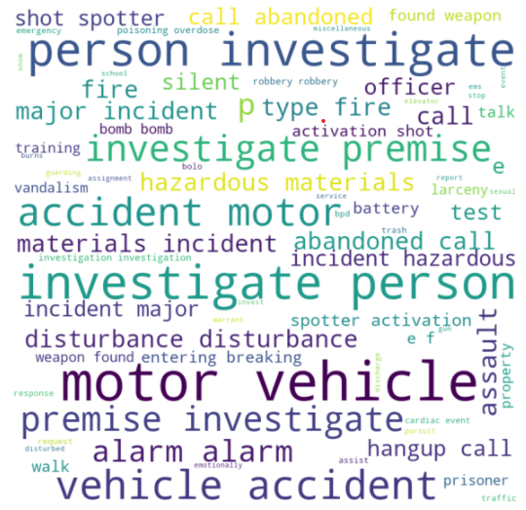
Other datasets which we worked
We even worked on 911 calls dataset to check the calls description and type of the crimes occurring area
As per the word cloud image we didn’t find any interesting feature which suites our dataset
As our problem statement defines that predicting crimes during evenings, we tried to correlate the crime rate with the street light locations
Unfortunately, the dataset which we found doesn’t fit our crime dataset as the shape of the dataset is very and there are no common features in them
Hence, we decided to start our modelling based on the features which we have in our crime dataset

Slide 46

Machine Learning Models for Prediction
Random Forest Model
Neural Network Model
K-Nearest Model
Decision Tree Model
Naïve Bayes Model
Kernel SVM Model
Support Vector Machine Model

Slide 47
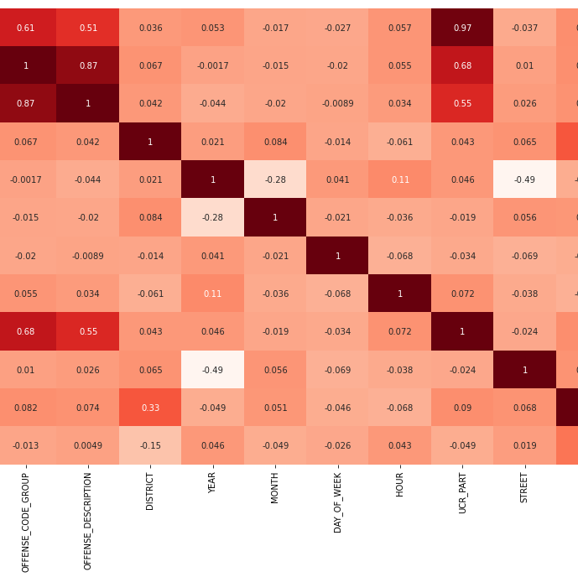
Heatmap to find the correlation between variables
Offense code and offense code group have positive correlation.
Offense code and offense description have positive correlation .
Offense code and UCR part have positive correlation .
Offense code group has positive correlation with UCR part.
Lat and street has negative correlation with year.
Year and month has negative correlation .
Long and UCR Part has negative correlation.

Slide 48
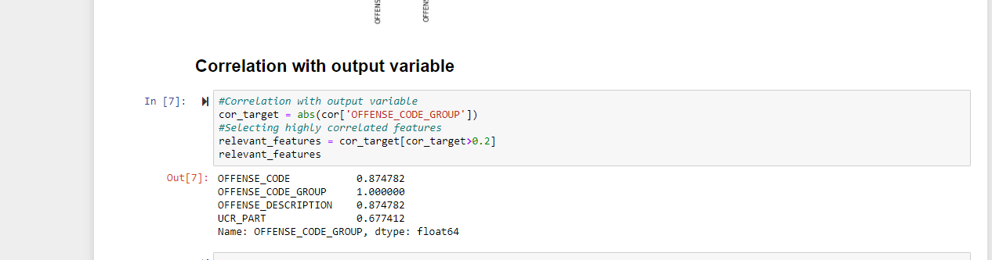
Checking Correlation with output variable and Choose to drop closely related variables offense_code and offense_Description

Slide 49

Dropping Correlated Variables
As Offense_code,Offense_Description and Offense_Code_Group are all positively Correlated
We have dropped Offense_code,Offense_Description and took Offense_Code_Variable as Target and remaining variables as features for Model Prediction.

Slide 50
K- Fold Cross Validation for Balancing the Target variable
We used K Fold cross validation for our Machine learning Models for better accuracy and balance the target variable
We used Folds = 10 for to remove the imbalance
After we have done K Fold cross validation our accuracy score was improved.

Slide 51
Random Forest Results before and after applying K-Fold cross validation
========== Random Forest==========
Accuracy : 0.7757415003780826
Recall : 0.8828828828828829
Precision : 0.8861993651192258
F1 Score : 0.8828828828828829
Used 80% of data for training and tested on the rest of 20% data.
The predictor features are “District","Year","Month","Day_Of_Week","Hour","Ucr_Part","Shooting" and the Target predictor is Offense_Code_Group was evaluated using a confusion matrix for train and test set.
The reason we selected Random forest model is because it works better on predicting a categorical variable.
Here our predictive variable offense code group is a categorical variable
# Applying k-Fold Cross Validation
from sklearn.model_selection import cross_val_score
accuracies = cross_val_score(nn_model , X=x1 , y=x2, cv = 10)
print("Accuracy: {:.2f} %".format(accuracies.mean()*100))
print("Standard Deviation: {:.2f} %".format(accuracies.std()*100))
Result :
Accuracy: 84.15 %
Standard Deviation: 2.99 %

Slide 52
Neural Network Results before and after applying k-Fold Cross Validation
========== Neural Network Results ==========
Accuracy : 0.5135135135135135
Recall : 0.5135135135135135
Precision : 0.3740416887475711
F1 Score : 0.5135135135135135
Used 80% of data for training and tested on the rest of 20% data.
The predictor features are “District","Year","Month","Day_Of_Week","Hour","Ucr_Part","Shooting" and the Target predictor is Offense_Code_Group was evaluated using a confusion matrix for train and test set.
Even though our random forest results are acceptable we still worked on Neural network models.
Neural network models gives good results when we have continuous variables in our feature selection.
As many of our features are continuous variables for an example month, year, hour etc., we didn’t get better score than random forest models
# Applying k-Fold Cross Validation
from sklearn.model_selection import cross_val_score
accuracies = cross_val_score(nn_model , X=x1 , y=x2, cv = 10)
print("Accuracy: {:.2f} %".format(accuracies.mean()*100))
print("Standard Deviation: {:.2f} %".format(accuracies.std()*100))
Result :
Accuracy: 58.50 %
Standard Deviation: 0.65 %

Slide 53
K-Nearest Result before and after applying K-Fold cross validation
Used 80% of data for training and tested on the rest of 20% data.
The predictor features are “District","Year","Month","Day_Of_Week","Hour","Ucr_Part","Shooting" and the Target predictor is Offense_Code_Group was evaluated using a confusion matrix for train and test set.
Since our target is to identify offense code group, K nearest model works good for predicting categories belongs to certain groups. Here we have certain offenses grouped in certain Districts for an example type offenses happening more frequently in a particular District.
Hence, we decided to work on K-nearest model and though our results are not pretty good
========== K-Nearest Neighbors ==========
Accuracy : 0.5403504140297958
Recall : 0.5375375375375375
Precision : 0.4667436786631832
F1 Score : 0.5375375375375375
# Applying k-Fold Cross Validation
from sklearn.model_selection import cross_val_score
accuracies = cross_val_score(nn_model , X=x1 , y=x2, cv = 10)
print("Accuracy: {:.2f} %".format(accuracies.mean()*100))
print("Standard Deviation: {:.2f} %".format(accuracies.std()*100))
Result :
Accuracy: 53.42 %
Standard Deviation: 1.89 %

Slide 54
Decision Tree Results before and after applying K-Fold Cross Validation
==========Decision Tree Results ==========
Accuracy : 0.9775052886766142
Recall : 0.990990990990991
Precision : 0.9927234927234928
F1 Score : 0.990990990990991
Used 80% of data for training and tested on the rest of 20% data. The predictor features
. The predictor features are “District","Year","Month","Day_Of_Week","Hour","Ucr_Part","Shooting" and the Target predictor is Offense_Code_Group was evaluated using a confusion matrix for train and test set.
Decision tree works best for both continuous variables and categorical variables in target, Here we have continuous features in X and categorical feature to predict.
# Applying k-Fold Cross Validation
from sklearn.model_selection import cross_val_score
accuracies = cross_val_score(nn_model , X=x1 , y=x2, cv = 10)
print("Accuracy: {:.2f} %".format(accuracies.mean()*100))
print("Standard Deviation: {:.2f} %".format(accuracies.std()*100))
Result :
Accuracy: 98.35 %
Standard Deviation: 0.74 %

Slide 55
NaiveBayes before and after applying K-Fold cross validation
==========Naive Bayes Results ==========
Accuracy : 0.8428813275422697
Recall : 0.9039039039039038
Precision : 0.9219507969507968
F1 Score : 0.9039039039039038
# Applying k-Fold Cross Validation
from sklearn.model_selection import cross_val_score
accuracies = cross_val_score(nn_model , X=x1 , y=x2, cv = 10)
print("Accuracy: {:.2f} %".format(accuracies.mean()*100))
print("Standard Deviation: {:.2f} %".format(accuracies.std()*100))
Used 80% of data for training and tested on the rest of 20% data. The predictor features
The predictor features are “District","Year","Month","Day_Of_Week","Hour","Ucr_Part","Shooting" and the Target predictor is Offense_Code_Group was evaluated using a confusion matrix for train and test set.
Result :
Accuracy: 88.13 %
Standard Deviation: 1.74 %

Slide 56
Kernel SVM model before and after applying K-Fold cross validation
=========Kernel SVM ==========
Accuracy : -0.463763001114603
Recall : 0.48348348348348347
Precision : 0.23375627880132385
F1 Score : 0.48348348348348347
# Applying k-Fold Cross Validation
from sklearn.model_selection import cross_val_score
accuracies = cross_val_score(nn_model , X=x1 , y=x2, cv = 10)
print("Accuracy: {:.2f} %".format(accuracies.mean()*100))
print("Standard Deviation: {:.2f} %".format(accuracies.std()*100))
Used 80% of data for training and tested on the rest of 20% data. The predictor features
The predictor features are “District","Year","Month","Day_Of_Week","Hour","Ucr_Part","Shooting" and the Target predictor is Offense_Code_Group was evaluated using a confusion matrix for train and test set
Result :
Accuracy: 48.46 %
Standard Deviation: 0.35 %

Slide 57
Support Vector Machine before and after applying K-Fold cross validation
==========Support Vector Machine==========
Accuracy : 0.6361824750248322
Recall : 0.5915915915915916
Precision : 0.5738443800943801
F1 Score : 0.5915915915915916
# Applying k-Fold Cross Validation
from sklearn.model_selection import cross_val_score
accuracies = cross_val_score(nn_model , X=x1 , y=x2, cv = 10)
print("Accuracy: {:.2f} %".format(accuracies.mean()*100))
print("Standard Deviation: {:.2f} %".format(accuracies.std()*100))
Used 80% of data for training and tested on the rest of 20% data. The predictor features
The predictor features are “District","Year","Month","Day_Of_Week","Hour","Ucr_Part","Shooting" and the Target predictor is Offense_Code_Group was evaluated using a confusion matrix for train and test set.
Result :
Accuracy: 65.73 %
Standard Deviation: 1.51 %

Slide 58
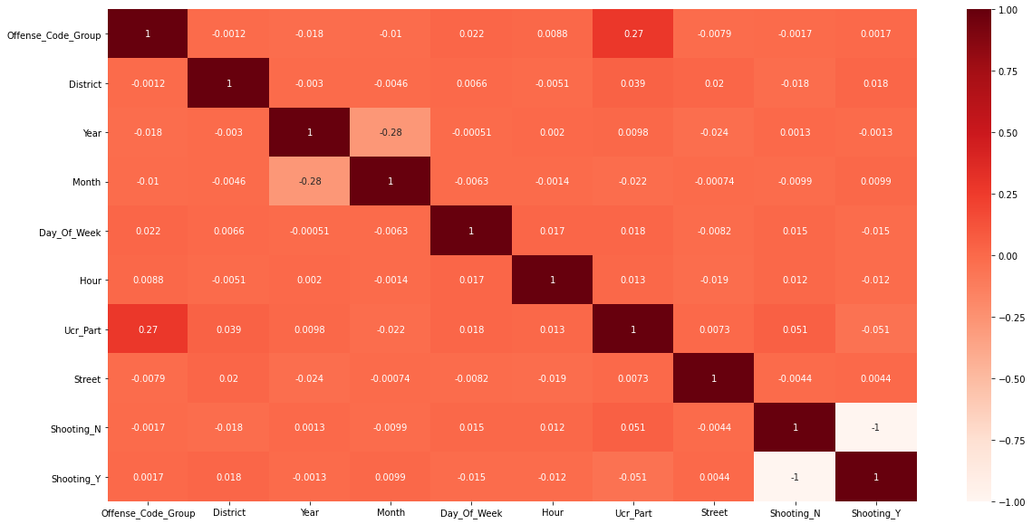
Machine learning models after changing the features and target feature
Features which we selected based on our EDA
Month of the crime happened, Day of the crime happened, Hour of the crime happened, offense code of the crime
The feature which we are predicting is crime type which is UCR_PART
In our dataset UCR_PART states the group of crimes happened on level 5 and others
For an example all the assault crimes belong to the part 1 type
Here we trained all the dataset and tested only 15 percent of the dataset

Slide 59
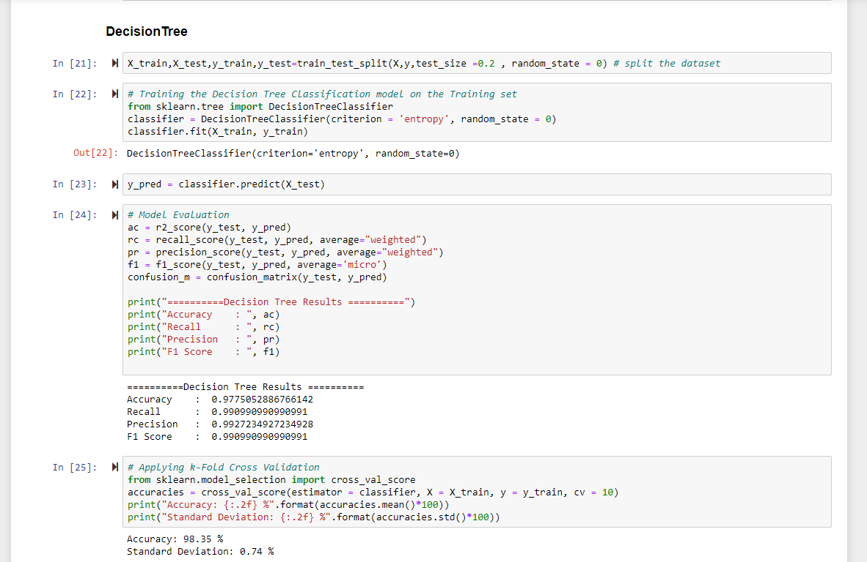
Best Model for Prediction -- Decision Tree

Slide 60
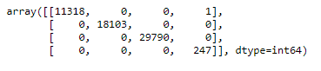
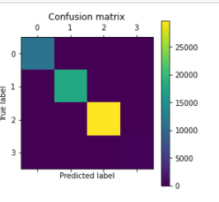
Decision tree classifier
Our model seems to be pretty good as our accuracy is 0.98 with the above features.
Since my features are continuous variables and didn’t find any imbalances in my data, I further decided to run my model.
Decision tree classifiers works best for both
continuous features and for predicting
categorical features
Here is the accuracy output and confusion matrix graph

Slide 61

Observations and findings from modelling
We initially performed our modelling on highest correlation features and got good results which we later found out was inappropriate
We then changed our feature selection and worked on the different type of features which are not related.
We found the best models suitable for our features based on their type.
During our modelling we didn’t observe data points overfitting in our models
Later we rectified it by using cross validation technique and obtained very good results shown in the next slide

Slide 62

Not Good Models for Prediction
Neural Network
Kernel SVM
K Nearest Neighbors
As the scores were not that good compared to other models

Slide 63
Best Machine Learning Models for Prediction by Order after K-Fold cross validation
1. Decision Tree Model 3. Random Forest Model
==========Decision Tree Results ==========
Accuracy : 0.9775052886766142
Recall : 0.990990990990991
Precision : 0.9927234927234928
F1 Score : 0.990990990990991
Applying K-Fold Cross Validation :
Applying k-Fold Cross Validation
Result :
Result:
Accuracy: 98.35 % Accuracy : 84.15%
Standard Deviation: 0.74 % Standard Deviation : 2.99%
2. Naïve Bayes Model 4. Support Vector Machine Model
==========Naive Beyes Results ========== ==========Support Vector Results ==========
Accuracy : 0.8428813275422697 Accuracy : 0.6361824750248322
Recall : 0.9039039039039038 Recall : 0.5915915915915916
Precision : 0.9219507969507968 Precision : 0.5738443800943801
F1 Score : 0.9039039039039038 F1 Score : 0.5915915915915916
Applying K-Fold Cross Validation : Applying k-Fold Cross Validation
Result : Result :
Accuracy : 88.13% Accuracy : 65.73%
Standard Deviation : 1.74% Standard Deviation : 1.51%
========== Random Forest==========
Accuracy : 0.7757415003780826
Recall : 0.8828828828828829
Precision : 0.8861993651192258
F1 Score : 0.8828828828828829

Slide 64

Difficulties which we faced
We faced lot of difficulties in finding out a suitable dataset to merge with this dataset to understand the correlation on the external events which can predict crime more accurately
We even faced difficulty in balancing the target variable and tried lot of methods like SMOTE,RandomOverSampler methods for balancing.
At last we used K-Fold cross validation with Folds =10 to balance the data.
Since our main goal is to predict the evening crimes, we tried to merge our dataset with street light dataset but was unsuccessful.
During geospatial analysis we tried layering the geospatial dataset with other geospatial datasets to identify certain locations using geopandas but we failed in doing so. Hence, we used other libraries such as folium, ArcGIS and tableau tool for layering geospatial dataset.

Slide 65

Observation and Findings
Found out Decision Tree, Naive Bayes, Random Forest and Support Vector models has good accuracy to predict Crime type based on the other features.
Most of the models gave good results based on the features and predicting offense code group type
Decision tree classifier gave good results in predicting the crime severity (Almost 98.35% accuracy)

Slide 66

Further analysis if continued
We would like to predict crime locations and type of crime occurring in that specific location.
For this we would like to correlate external geographic information such as popular communities, demographics and census information.

Slide 67

THANK YOU

